Slide 1
BEER DATA
ANALYSIS, VISUALIZATION, CORRELATION, LINEAR REGRESSION

Slide 2
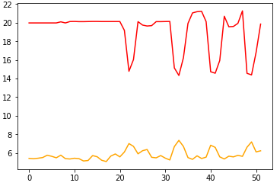
12pk [Price, Weeks, Cases]

Slide 3
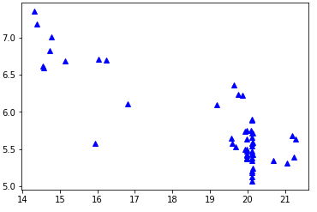
Cases
Price

Slide 4
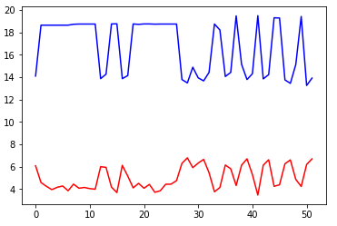
18pk [Price, Weeks, Cases]

Slide 5
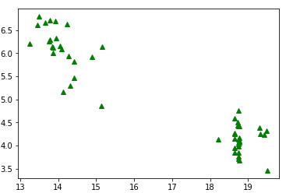
Cases
Price

Slide 6
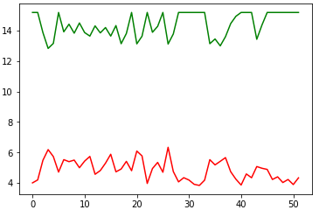
30 pk [Price, Weeks, Cases]

Slide 7
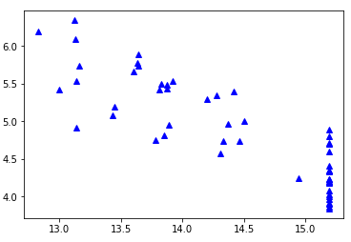
Cases
Price

Slide 8
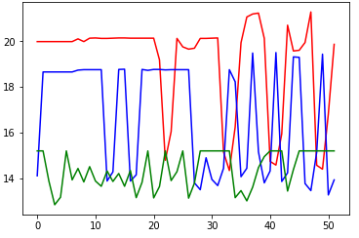

Slide 9
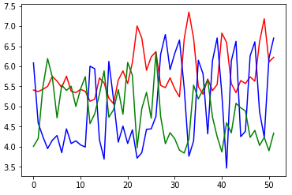

Slide 10
CORRELATION AND LINEAR REGRESSION

Slide 11
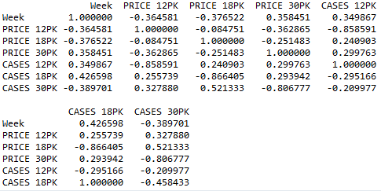

Slide 12
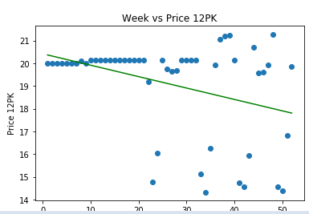

Slide 13
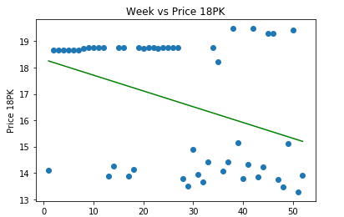

Slide 14
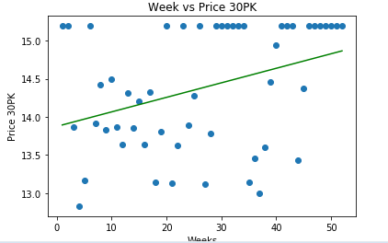

Slide 15
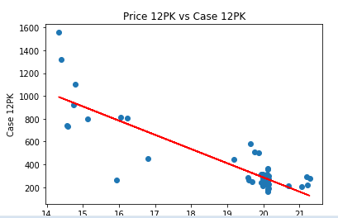

Slide 16
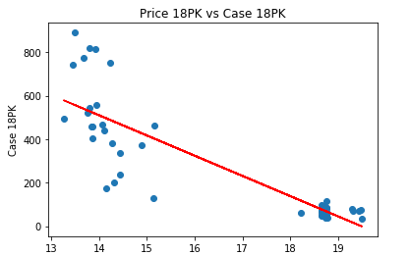

Slide 17
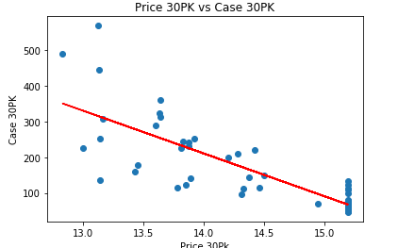

Slide 18
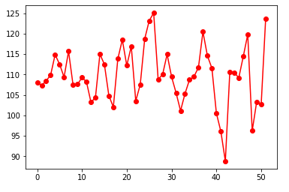
INCOME OF 12PK
Price
Week

Slide 19
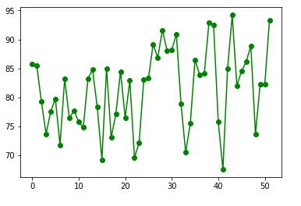
INCOME OF 18PK
Price
Week

Slide 20
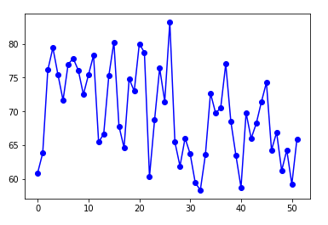
INCOME OF 30PK
Price
Week

